Slide 1
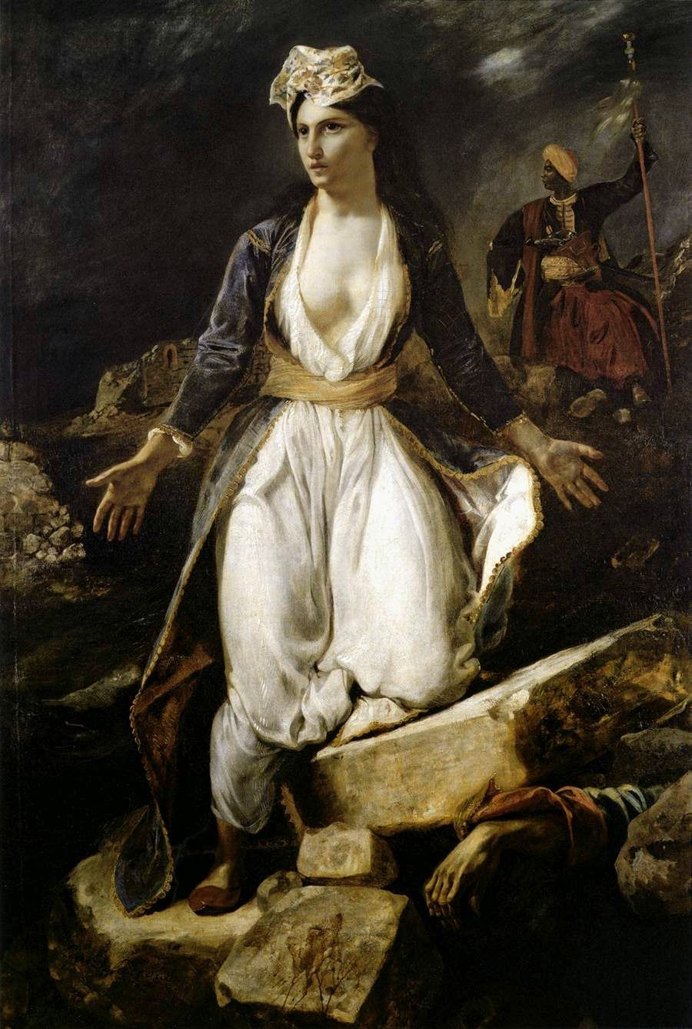
Greece in the ruins of Missolonghi
Stergios Molyvas
Myrsini Sofikitis
Zeta Matzorou
Georgia Liari
Vaggelis Raptis
Eugène Delacroix
Painter (1798–1863)

Slide 2
Exit of Missolonghi
Exit of Missolonghi refers to the exit made by the besieged soldiers and civilians of Missolonghi, when the possibilities of continuing the defense against the Turkish and Egyptian troops were lost, due to food shortage. The event took place on the night between the tenth and eleventh of April 1826, during the revolution of 1821.

Slide 3
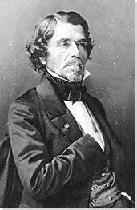
A short biography of the artist
Eugene Delacroix was born on 26 April 1798 in Charenton-Saint Maurice near Paris and was the fourth child of Charles Delacroix, Minister of Foreign Affairs of the Director, although it is assumed that his real father was Talleyrandos, a famous diplomat to whom Eugene looked like both in appearance and in character.

Slide 4
A short biography of the artist
Charles Delacroix died in 1805 and his mother in 1814 leaving Eugene orphaned at the age of 16. In 1815, he taught near the painter Pierre-Narcisse Guérin and in 1816, he joined the School of Fine Arts. In 1822, he presented at the Paris Salon his painting "Dante's Boat".

Slide 5
A short biography of the artist
In 1824, he presented the "Massacre of Chios", inspired by the real event of the Greek revolution, and the painting was purchased by the French government for 6000 coins.

Slide 6



The artist’s work
Eugene Delacroix was a great 19th century French romantic painter who influenced painting by contributing to the development of Impressionism. Between 1827 and 1832 he presented many great works with historical themes.

Slide 7
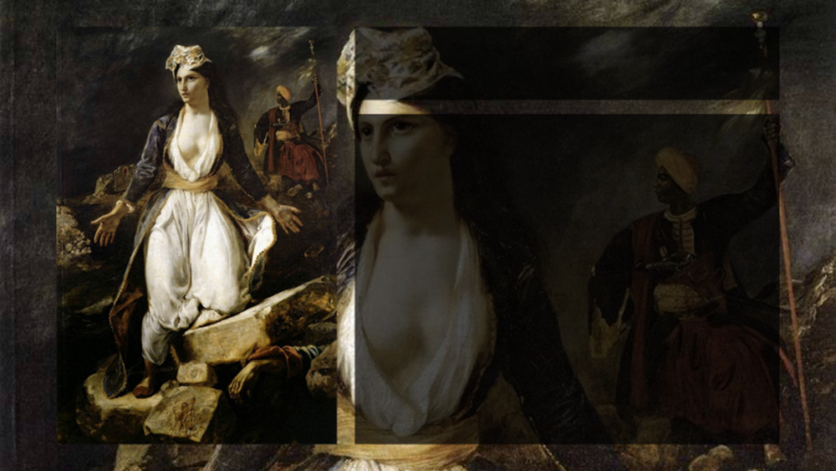
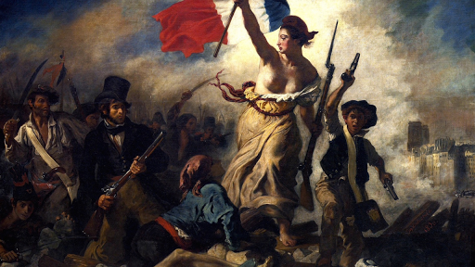
The artist’s work
In 1827, he presented at the Salon the "Death of Sardanapalos" inspired by the poetry of Lord Byron. He impressed the audience again with his most important and latest romantic work, "Freedom Leads the People", inspired by the Julian Revolution of 1830.

Slide 8

The artist’s work
The painting was also bought by the French government but thanks to the reaction of some officials who considered the promotion of the idea of freedom subversive, was withdrawn from public view. Nevertheless, Delacroix took several contracts for murals in public buildings.

Slide 9
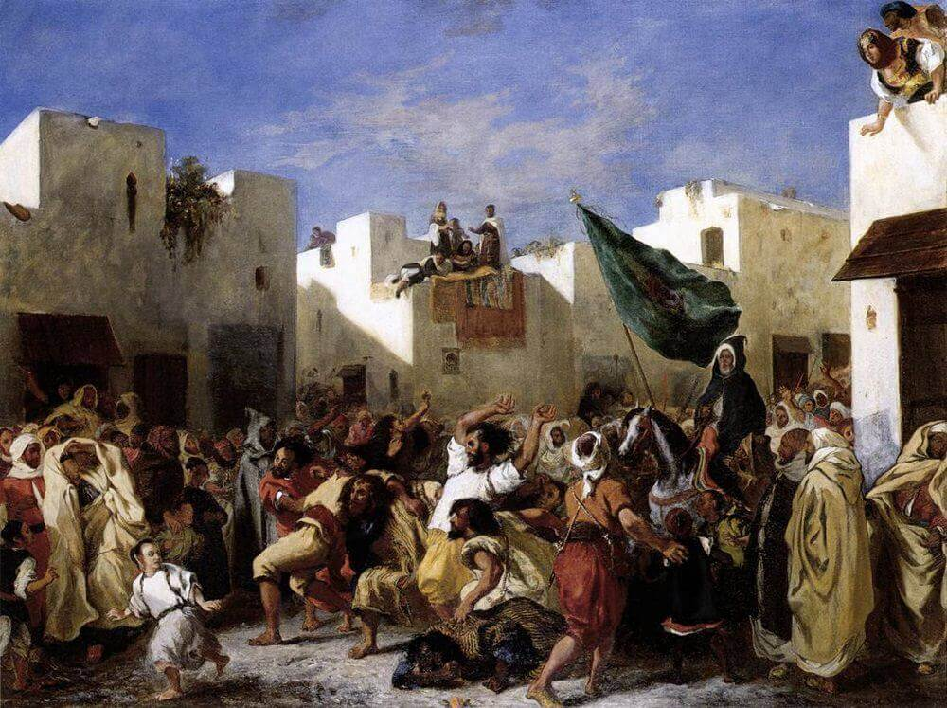
The artist’s work
In 1832, he traveled for 6 months to Morocco where the ancient and exotic culture of the Arabs inspired him again to create works such as "The Fanatics of Tangier" (1837-1838), "The Sultan of Morocco and his Sequence (1845), "Lion Hunt" (1854), "Arab Horseshoe Horse" (1855).

Slide 10
The artist’s work
The "Women of Algeria" was a great success at the Salon of 1834. In 1833, he painted the frescoes in the royal room of the Bourbon Palace, and continued with various works for the Louvre and the Historical Museum in Versailles, until 1861.

Slide 11
The artist’s work
His other works include "The Shipwreck of Don Juan", "Medea before she kills her children", "The Crusaders enter Istanbul" and a portrait of the composer Frederic Chopin.

Slide 12
The artist’s work
His works inspired by the Greek revolution are "The Massacre of Chios", "Equestrian Greek fighter", "Greece in the ruins of Missolonghi " and "The Battle of Giaouris with Pasha".

Slide 13
.
The artist’s work
In 1855, he exhibited 48 paintings at the Paris International Fair and was admitted to the Academy after his eighth application.
Making murals for many hours standing on the scaffolding of half-finished buildings, he fell ill and retired.

Slide 14


Information about the painting
Eugene Delacroix created “Greece in the ruins of Missolonghi” in 1826 with oil on canvas. Today, this painting is in the Bordeaux Museum of Fine Arts.

Slide 15
What the painting shows
The painting depicts the personification of heroic Greece. She is wearing a Greek traditional costume .
She is facing the viewer with her hands in a state of despair , and her face in three quarters facing left .

Slide 16
What the painting shows
She is standing on the ruins of Missolonghi, which have crushed a fighter. In the background a man in a yellow turban symbolizing the enemy nails a flag to the ground .

Slide 17
Thank you for your attention !

